Slide 1
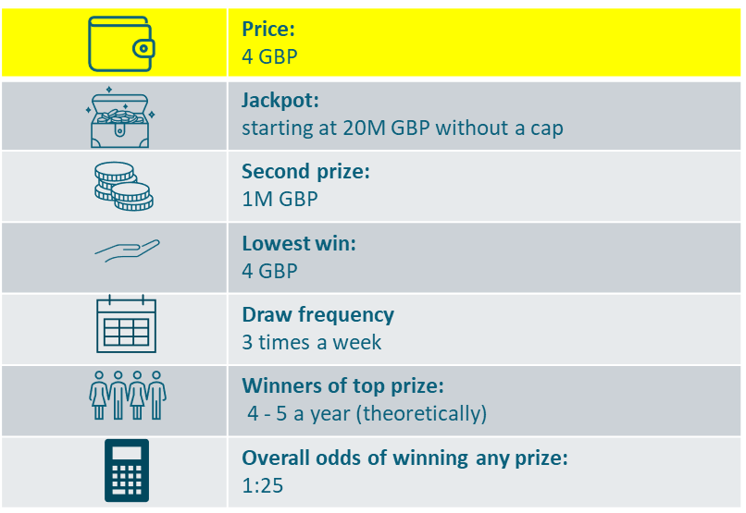
Powerball Imagine that there is a new lottery game to be launched:
This lottery game would be offered internationally. Thanks to the shared pool between many participating countries, this would be the world´s biggest lottery. Its jackpot can exceed half a billion GBP. The average jackpot would be about a quarter of a billion GBP. The minimum jackpot size would be guaranteed at 20 million GBP.
To enter, you select 5 numbers out of 69 and 1 number out of 26 for each line played, or simply select a random lucky dip option.
Price per participation is 4 GBP. For this price you get 2 lines, in other words two chances to match the 5+1 numbers.
There would be three draws per week, held every Monday, Wednesday and Saturday. The top prize would be won (theoretically) 4-5 times a year.
In the UK, this game would be offered in all points of sale where you can buy lottery tickets or scratch cards or online on respective websites and apps.
Notes:
Concept 1 - Powerball

Slide 2
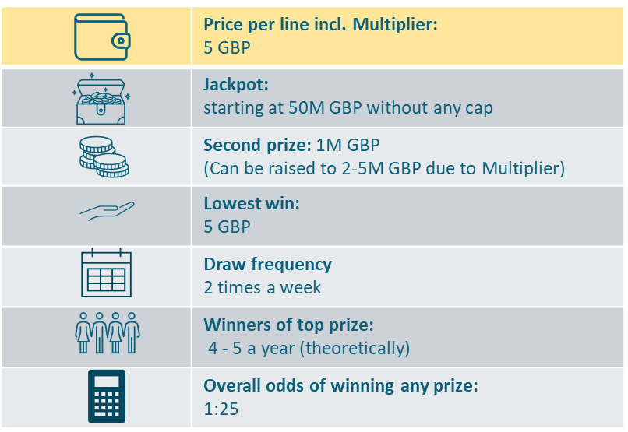
MegaMillions Imagine that there is a new lottery game to be launched:
This lottery game would be offered internationally. Its jackpot can reach as high as 1 billion GBP. The average jackpot would be about a quarter of a billion GBP. The minimum jackpot would be guaranteed at 50 million GBP. The jackpot would be paid in annual installments for 30 years. Payouts can be inherited as well.
To enter, you select 5 numbers out of 70 and 1 number out of 25 for each line played, or simply select a random lucky dip option.
Together with the main game, there would also be an add-on game that multiplies all winnings (except for the jackpot) by 2-5 times. The Multiplier number would be drawn before each draw. Therefore, players who win 1 million in the second prize tier can multiply their winnings to 2, 3, 4 or 5 million GBP.
Price per participation is 5 GBP. For this price you get 1 line of the main game and also the add-on multiplier.
There would be two draws per week. The top prize would be won (theoretically) 4-5 times a year.
In the UK, this game would be offered in all points of sale where you can buy lottery tickets or scratch cards or online on respective websites and apps.
Notes:
Concept 2 - MegaMillions

Slide 3
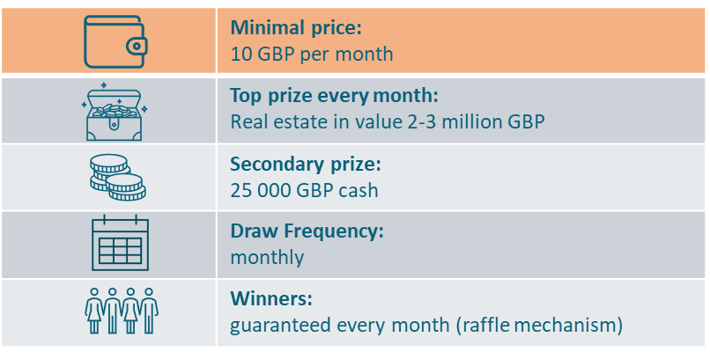
Omaze-inspired Imagine that there is a new lottery game to be launched:
This lottery would be a monthly raffle played internationally. Thanks to the shared pool, it could offer exclusive dreamy houses every month. It could be a villa in Spain in the January draw, then a luxurious condo in the Alps in February, a penthouse overlooking ancient Rome, or a bungalow on a Caribbean island.
There will also be hundreds of cash prizes of 25 000 GBP.
To enter the game, you do not need to choose any numbers. Your purchase generates a unique code which will be put into a database. It means, the more entries you buy, the more times your code will appear in the database. Then, at the end of the month, the winner will be drawn using a randomised draw engine.
The only way to purchase is via online subscription.
You can choose how many times you want your code to be put into the database. For 10 GBP a month, you get 30 entries into the monthly raffle. For 30 GBP a month, you get 100 entries.
For those players who participate in all 12 draws of the year, there will be a free Grand Draw on New Years Day with a multi-million prize on top of the monthly prizes.
The subscription can be cancelled anytime during the year.
Notes:
Concept 3 – Omaze-inspired

Slide 4
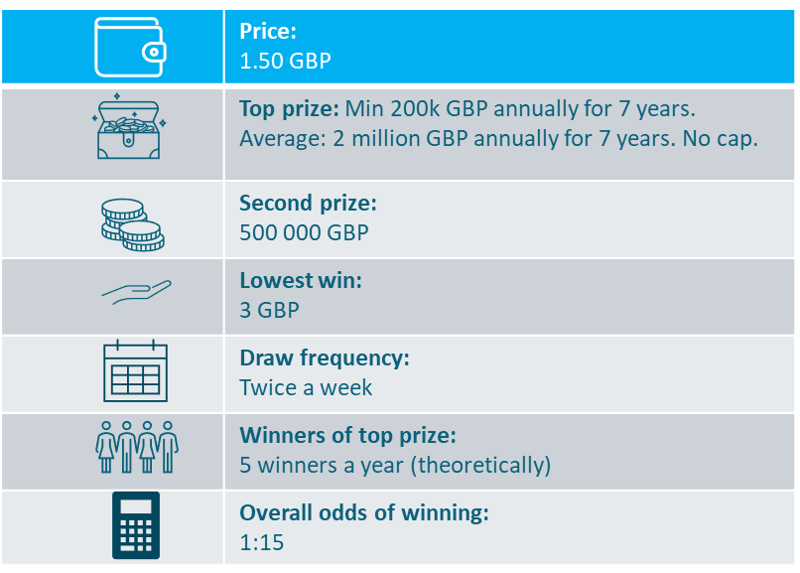
Progressive annuity Imagine that there is a new lottery game to be launched:
This lottery game would be offered internationally. Thanks to the shared pool among participating countries, the game can offer a substantial top prize in the form of an annual payment, starting at a minimum of 200 000 GBP per year for 7 years, and potentially reaching as high as 5 million GBP annually for 7 years.
If the top prize is not won in the initial round, there is a rollover. The top prize then increases from 200 000 GBP to 270 000 GBP annually for 7 years and continues to grow after each draw until it is won.
To enter, you select 7 numbers out of 45 or opt for a lucky dip option.
Price per 1 entry is 1.50 GBP.
There would be 2 draws of the game a week. The top prize would be won (theoretically) once in 10 weeks.
In the UK, this game would be offered in all points of sale where you can buy lottery tickets or scratch cards or online on respective websites and apps.
Notes:
Concept 4 – Progressive annuity

Slide 5
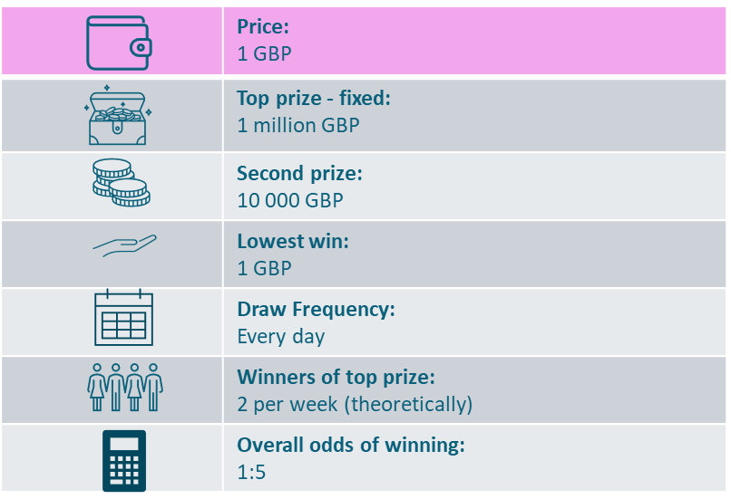
Daily Millionaire Imagine that there is a new lottery game to be launched:
This lottery would be offered internationally and would allow players to win a fixed top prize of 1 million GBP on a daily basis.
To enter, you select 6 numbers out of 40 or opt for a random lucky dip option.
Price per 1 entry is 1 GBP.
The top prize would be won (theoretically) once in 3 draws. The overall odds of winning any prize are rather high in this game – one in five lines.
Draws would take place every evening in Finland.
In the UK, this game would be offered in all points of sale where you can buy lottery tickets or scratch cards or online on respective websites and apps.
Notes:
Concept 5 – Daily Millionaire

Slide 6
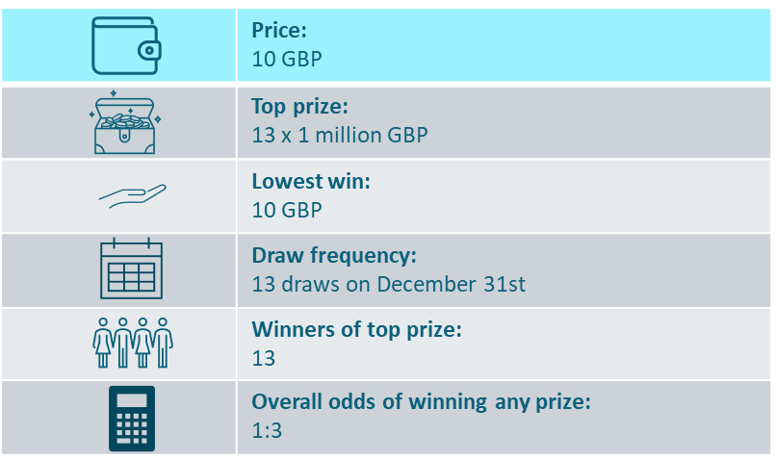
New Years Eve 13 millionaires Imagine that there is a new lottery game to be launched:
This lottery would be a once-a-year game, played only on New Year's Eve in several countries. There would be 13 draws throughout the day, every hour on the hour, starting at noon and ending at midnight.
Thanks to the shared pool among participating countries, the game can offer thousands of prizes in each draw. The 13th draw, which would take place at midnight, would be a special draw determining 13 winners of a final cash prize of 1 million GBP each.
One ticket costs 10 GBP, and this ticket grants entry to all 13 draws. Each ticket can be divided into 5 parts and shared with family and friends.
To enter, you do not need to choose any numbers; the ticket contains a unique code (a combination of numbers and letters) that serves as an entry for each draw.
The sales start on December 1st. In the UK, this game would be offered in all points of sale where you can buy lottery tickets or scratch cards or online on respective websites and apps.
Notes:
Concept 6 – New Years Eve 13 millionaires

Slide 7
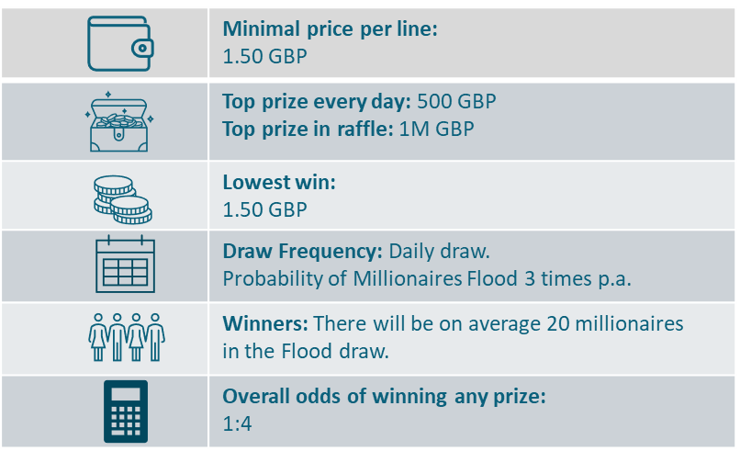
Millionaires Flood Imagine that there is a new lottery game to be launched:
This lottery would be a daily game. It would be offered internationally and thanks to the shared pool, there would be a special feature called “Millionaires Flood” on top of the regular prizes. A portion of the revenue will be collected in the Millionaires Flood Fund, which can reach over 50 million GBP.
To enter the game, choose your 5 numbers out of 17 and watch the evening draw to find out not only if you match the winning numbers, but also to see if it is the day of "Millionaires Flood“. It would happen at every draw in which all the 5 drawn numbers are even. For example, if on that day, there is 25.5 million GBP in the Fund, then 25 players will be selected based on their ticket code. These players then win 1 million GBP each.
The minimum price for entry would be 1.50 GBP which would give you the chance to win in one of the 6 winning categories in the daily game. Moreover, your lottery ticket qualifies you for the Millionaires Flood raffle if it occurs in the given draw.
In the UK, this game would be offered in all points of sale where you can buy lottery tickets or scratch cards or online on respective websites and apps.
Notes:
Concept 7 – Millionaires Flood

Slide 8
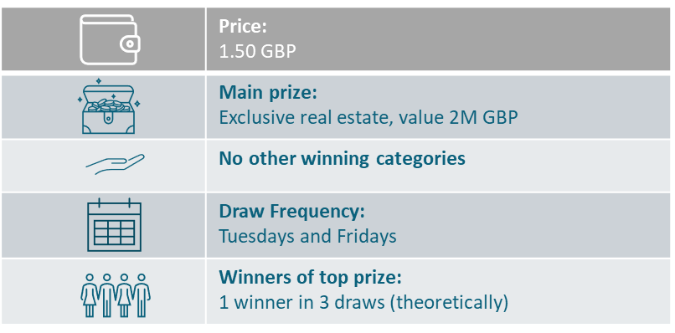
Real estate prizes added to existing lottery Imagine that there is a new add-on game for players of the Euromillions lottery game:
This new game would be an add-on to the Euromillions game. For an additional 1.50 GBP per ticket, players would also participate in an additional raffle draw where they could win exclusive non-cash prizes such as villas in the Mediterranean, the Swiss Alps, famous European spa resorts, or penthouses in European metropolises, apartment at Lake Como etc. These exclusive prizes can be offered thanks to an internationally-shared pool.
To participate in this add-on raffle, players do not need to select any numbers. The serial number of the ticket will be automatically entered into the raffle if the extra 1.50 GBP is paid.
Draws for the add-on raffle would coincide with the draws of the Euromillions game.
Notes:
Concept 8 – Real estate prizes added to Euromillions

Slide 9
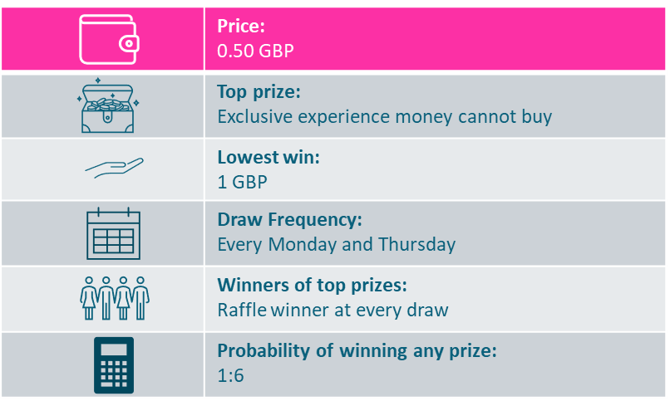
Experiential prizes added to annuity lottery (SFL) Imagine that there is a new add-on game offered for players of the Set For Life lottery game:
This add-on game to Set For Life would be offered internationally. Players would have the chance to win exclusive experiential prizes that money cannot buy. Examples could be:
Tickets to the Olympic Games including meeting with athletes, trips to Formula 1 races with a VIP travel package, Gold Class tickets to concerts and festivals.
Roles as extras in hit TV shows or films, being a judge in cooking/baking TV shows or popular talent shows, cast in reality shows, spend a training day with a pro football team, F1 driving simulator experience.
Scuba diving training with a celebrity instructor, exclusive film premieres with dinner, luxury cruises with celebrity guides, premium e-sports packages, arts and culture tours around the world, and Broadway or West End theatre trips.
Winners would be given a choice from a number of alternatives.
Price per 1 entry would be 0.50 GBP per line played.
To participate in this add-on, players do not need to select any numbers. There will be a special code printed underneath each line of Set For Life played. These codes would be automatically entered into the raffle.
This raffle draw would take place twice a week, every Monday and Thursday.
Notes:
Concept 9 – Experiential prizes added to annuity lottery (SFL)

Slide 10
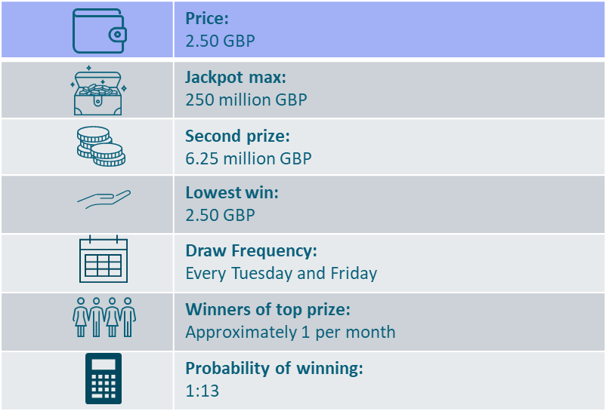
Euromillions (benchmark) Imagine that there is a new lottery game to be launched:
This lottery numbers game would offer the chance to win substantial progressive jackpots on a regular basis.
To enter, pick 5 numbers and 2 bonus numbers for the chance to win the ultimate jackpot of up to 250 million GBP.
Tickets would cost 2.50 GBP per line.
This game could be played online or in retail stores. If the jackpot is not won, the total sum rolls over to the next draw.
Draws would take place twice per week: every Tuesday and Friday. The probability of winning a prize in each is 1 in 13.
Notes:
Concept 10 – Euromillions (benchmark)

Slide 11
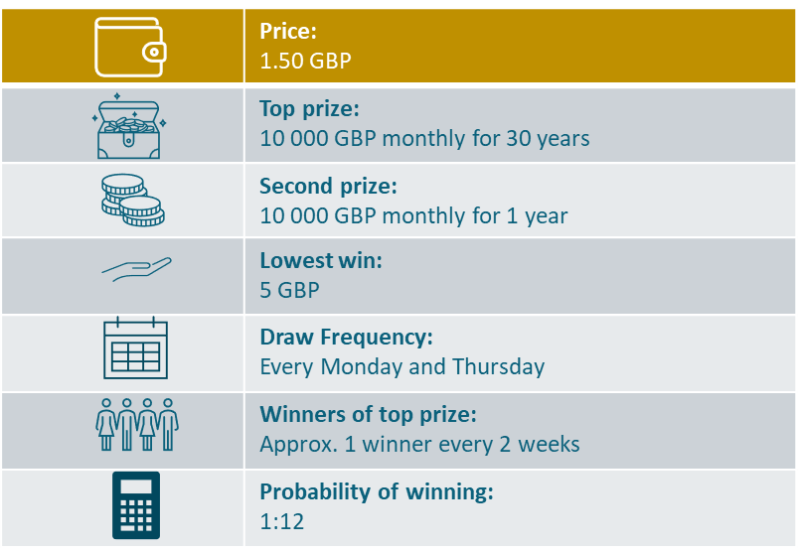
Set for life (benchmark) Imagine that there is a new lottery game to be launched:
This is a national lottery numbers game in which players from participating countries play to win a top prize of 10 000 GBP per month, which is paid in regular instalments over a 30-year period.
To enter, pick 5 numbers from 1 to 47 and 1 bonus number from 1 to 10. If you match all 7 numbers, you win the top prize. This prize is fixed.
There would be an annuity prize also in the 2nd tier: 10 000 GBP per month for 1 year.
One row would cost 1.50 GBP.
There would be two draws per week: on Mondays and Thursdays.
In the UK, this game would be offered in all points of sale where you can buy lottery tickets or scratch cards or online on respective websites and apps.
Notes:
Concept 11 – Set for life (benchmark)

